Slide 1
Gradual Change in Mutation Rate in NIMR

Slide 2




One transition mutation rate between the non-mutator and the mutator
Instead of:
1-γ
1-γ
Non
-
mutator
γ
Mutator
$$μ$$
$$τμ$$
Now we have:
1-γ
1-δ
1-γ
γ
δ/2
Non
-
mutator
Transition
Mutator
$$μ$$
$$τμ$$
δ/2
γ
mutation rate is the geometric mean between µ and τµ

Slide 3
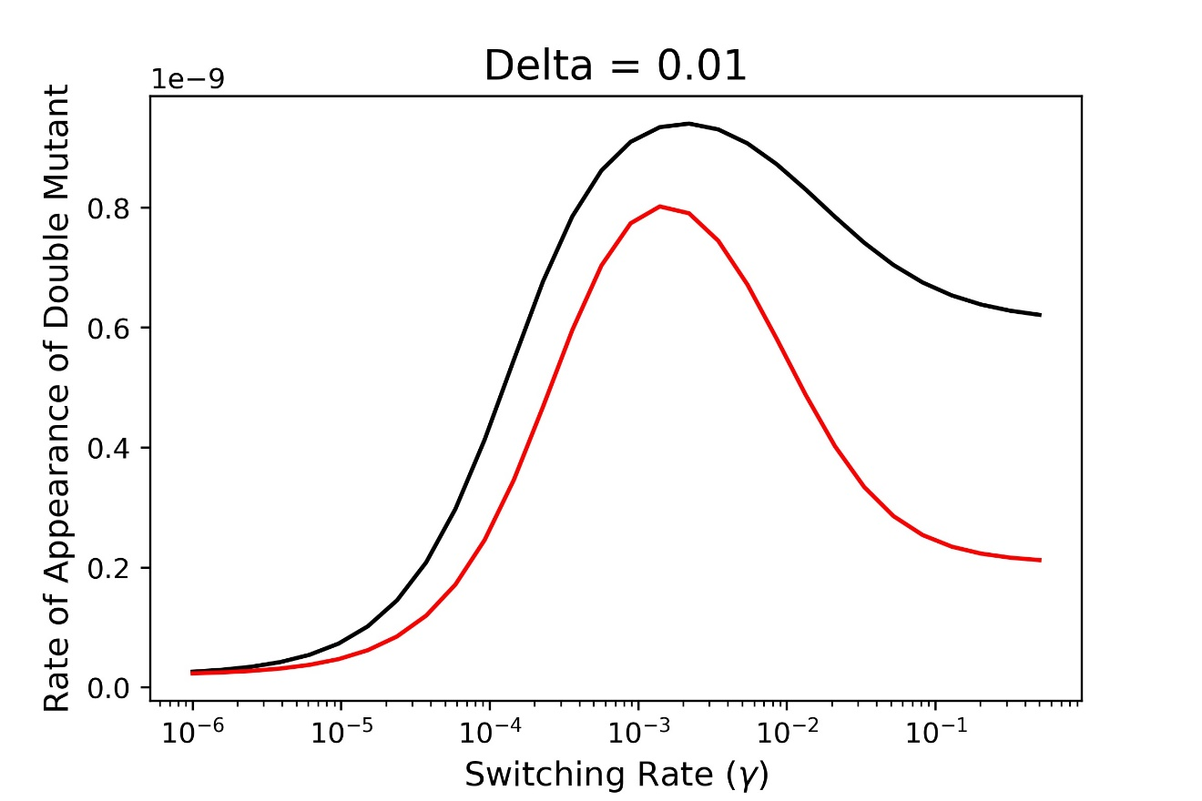
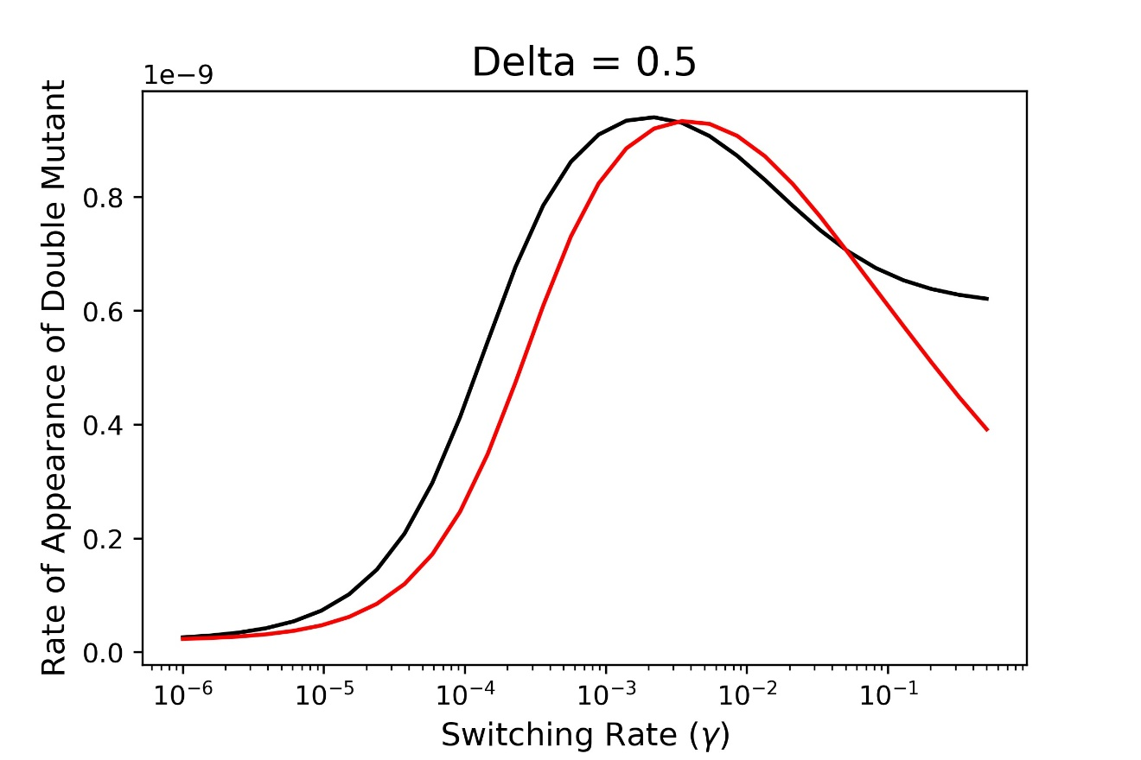
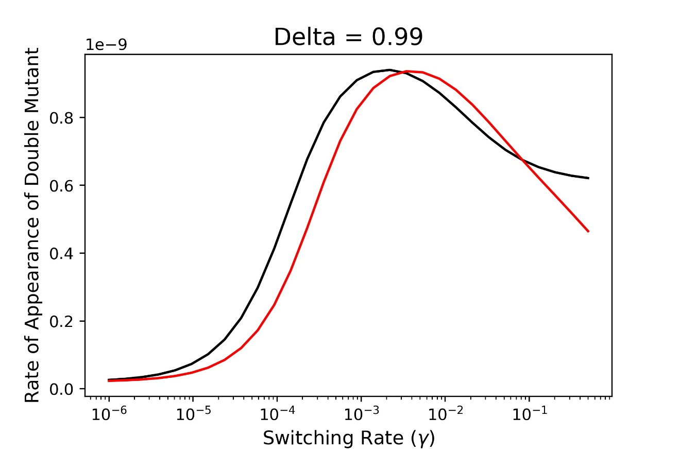
Calculated Rate of Adaptation
two mutation rates
two mutation rates
+ transition
Two main differences:
shift of the curve towards the right
higher ratio of epigenetic:random

Slide 4
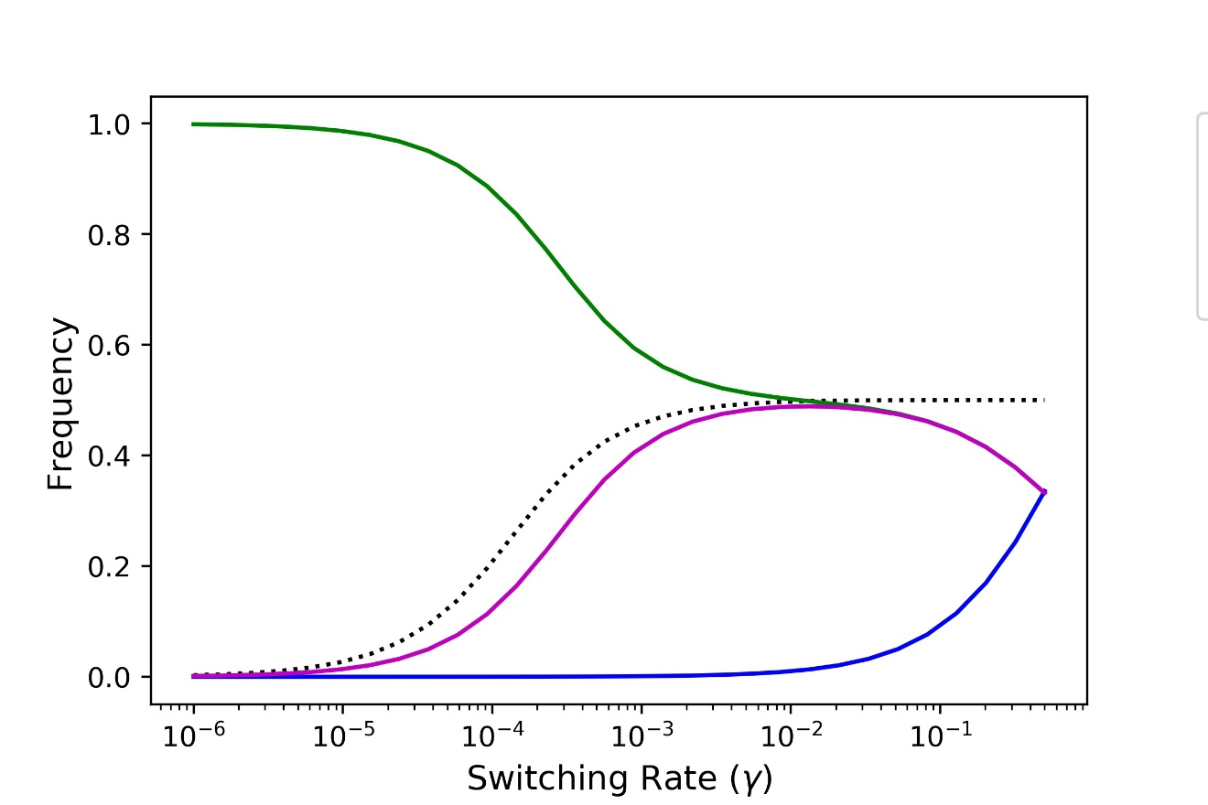


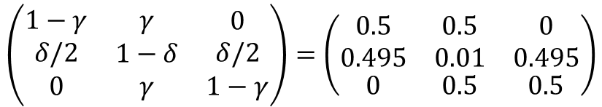
Markovian steady state explains the lower rate of adaptation for random switching rate
Example for matrix for delta = 0.99 and gamma = 0.5:
$$\left(\begin{matrix}\begin{aligned}1−γ \\ δ/2\end{aligned} & \begin{aligned}γ \\ 1−δ\end{aligned} & \begin{aligned}0 \\ δ/2\end{aligned} \\ 0 & γ & 1−γ\end{matrix}\right)=\left(\begin{matrix}\begin{aligned}0.5 \\ 0.495\end{aligned} & \begin{aligned}0.5 \\ 0.01\end{aligned} & \begin{aligned}0 \\ 0.495\end{aligned} \\ 0 & 0.5 & 0.5\end{matrix}\right)$$
Markovian Steady State:
$$\left(0.332,0.336,0.332\right)$$
At random swiching rate, the proportion of mutators is lower since a large proportion of the population will be in the transition category.

